Slide 1

CRM ANALYTICS

Slide 2
GROUP NO: 06 (P_263) TEAM MEMBERS
ANKUSH
BHUMIKA
DARREN
RAKSHITH
SHARATH K P
TUHINAA
VINEETH

Slide 3
SUMMARY:
CRM analytics refer to the ability to collect and organize data across your business and analyze it to produce informative reports.
CRM (Customer Relationship Management) helps you keep track of everything about your customers and your potential customers so you can build great relationships with them.
It provides users with real-time, actionable insights to help them identify trends, track KPIs, improve customer engagement, optimize sales processes, and ultimately drive business growth.
It delivers industry-oriented processes and valuable insights for workflow and ensure constant behavior and pattern company-wide.

Slide 4
How it works:
The most commonly used CRM analytics features are:
Customer retention
Customer acquisition
Report generation
Data management

Slide 5
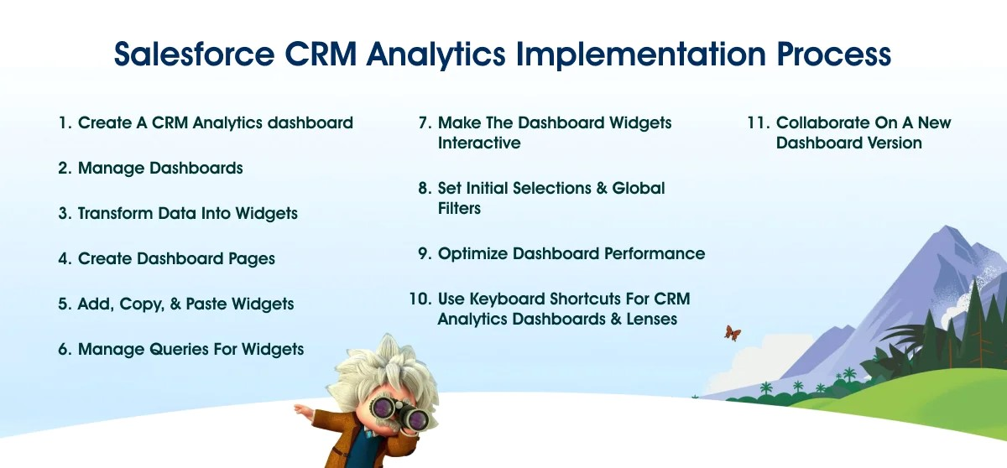

Slide 6
OPPORTUNITY KPIs:
EXPECTED AMOUNT
ACTIVE OPPORTUNITIES
CONVERSION RATE
WIN RATE
LOSS
TREND ANALYSIS
RUNNING TOTAL EXPECTED VS COMMIT FORECAST AMOUNT OVER TIME
RUNNING TOTAL ACTIVE VS TOTAL OPPORTUNITIES OVER TIME
CLOSED WON VS TOTAL OPPORTUNITIES OVER TIME
CLOSED WON VS TOTAL COSED OVER TIME
EXPECTED AMOUNT BY OPPORTUNITY TYPE
OPPORTUNITIES BY INDUSTRY

Slide 7
LEAD KPIS:
TOTAL LEAD
EXPECTED AMOUNT FROM CONVERTED LEADS
CONVERSION RATE
CONVERTED ACCOUNTS
CONVERTED OPPORTUNITIES
LEAD BY SOURCE
LEAD BY INDUSTRY

Slide 8
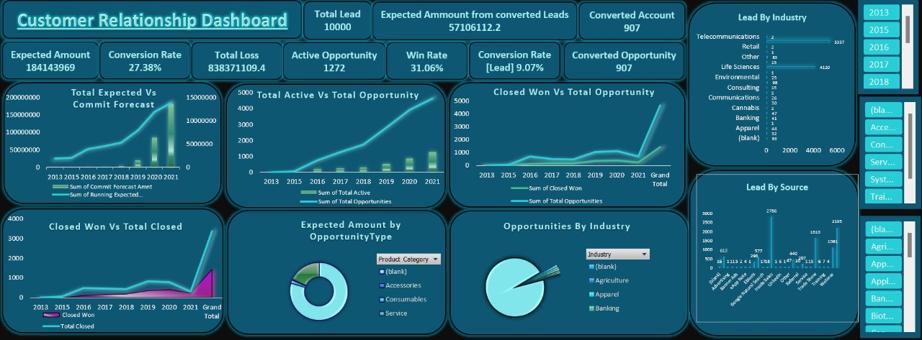
EXCEL:

Slide 9
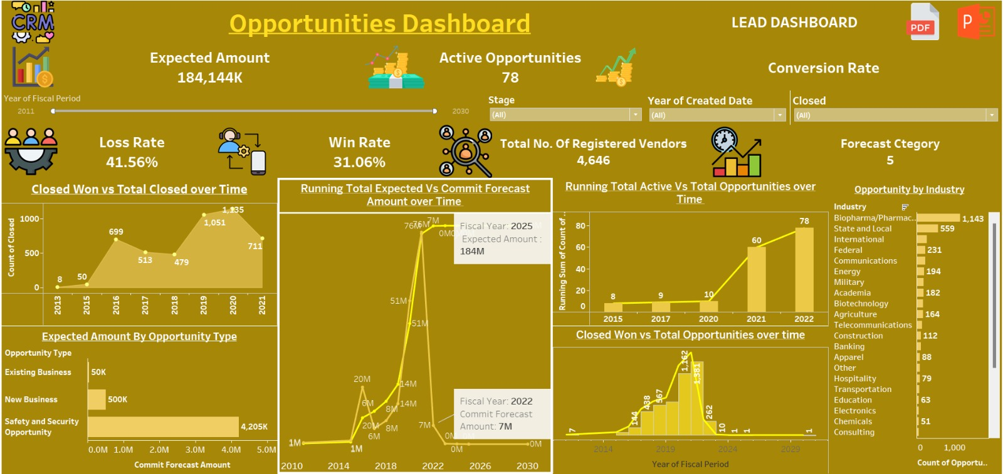
TABLEAU:

Slide 10
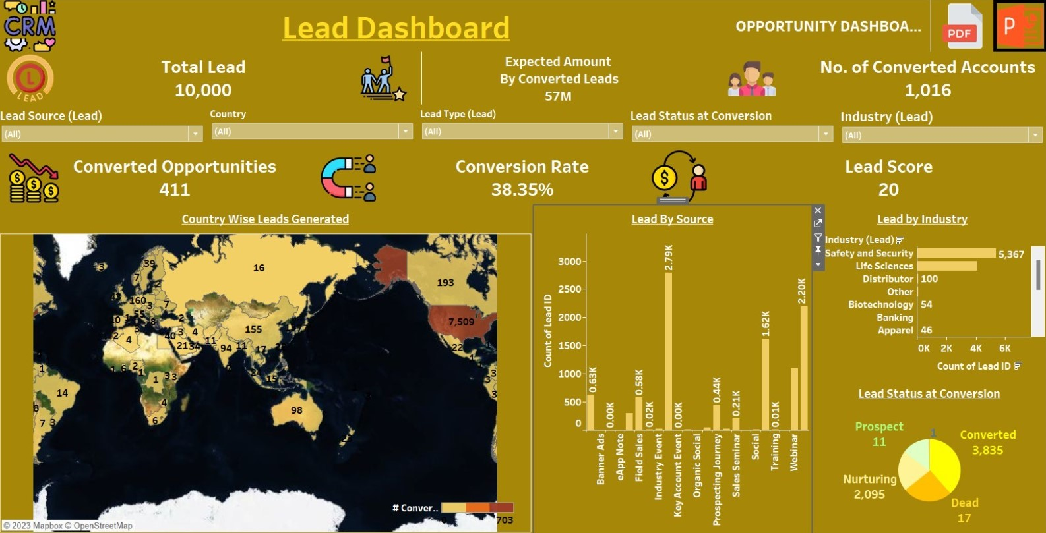
TABLEAU:

Slide 11
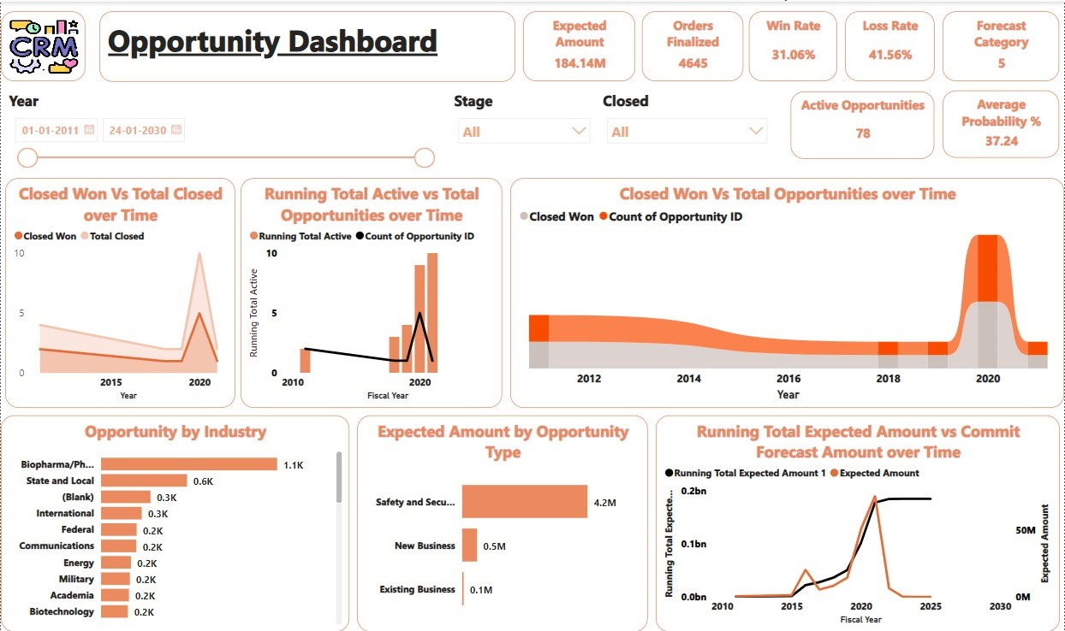
POWER BI:

Slide 12
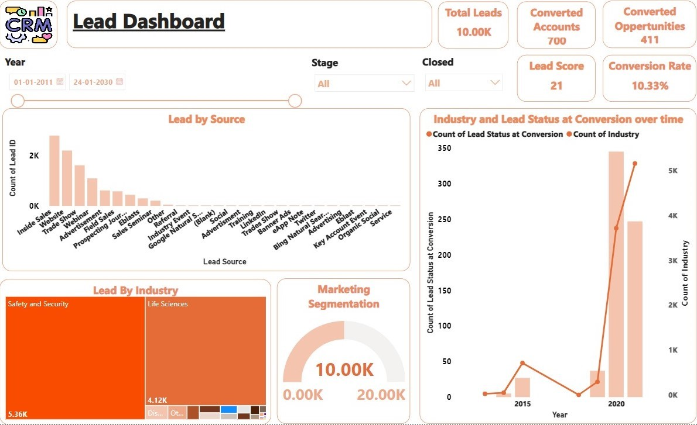
POWER BI:

Slide 13
KEY TAKEAWAYS:
From 2013 to 2021, There has been an increase in opportunities and along with that the active opportunities.
Based on industries, Biopharma/pharma stood the highest in terms of number of Opportunities(1.1k).
We can clearly notice that based on opportunity types; Safety and security has obtained the highest amount of 4.2 Millions.
The top three sources on obtaining leads are Inside sales(2786), website(2195) and trade shows(1610).
Based on industries, safety & security and life sciences commands a huge share of leads with 5.36 K and 4.12 K leads respectively.

Slide 14
FINAL TAKEAWAYS:
From the Opportunity Dashboard :-
The Year 2020 has provided with the highest opportunities with Biopharma/pharma (industry) obtaining 352 opportunities and safety & securities(Opportunities Type) obtaining 0.44 Millions.
2. From the Lead Dashboard :-
The Year 2020 has provided with the highest leads with Website (source) obtaining 36 leads and Life Sciences(Industry) obtaining 50 Leads.

Slide 15
THANK YOU

